Slide 1
Approximations & Round-off Errors
1
Chapra: Chapter-3

Slide 2
For many engineering problems, we cannot obtain analytical solutions
Numerical methods yield approximate solution that are close to the exact analytical solution. We cannot exactly compute the errors associated with numerical methods.
Only rarely given data are exact, since they originate from measurements. Therefore there is probably error in the input information.
Algorithm itself usually introduces errors as well, e.g., unavoidable round-offs, etc …
The output information will then contain error from both of these sources.
How confident we are in our approximate result?
The question is “how much error is present in our calculation and is it tolerable?”

Slide 3
Accuracy. How close is a computed or measured value to the true value
Precision (or reproducibility). How close is a computed or measured value to previously computed or measured values.
Inaccuracy (or bias). A systematic deviation from the actual value.
Imprecision (or uncertainty). Magnitude of scatter.

Slide 4
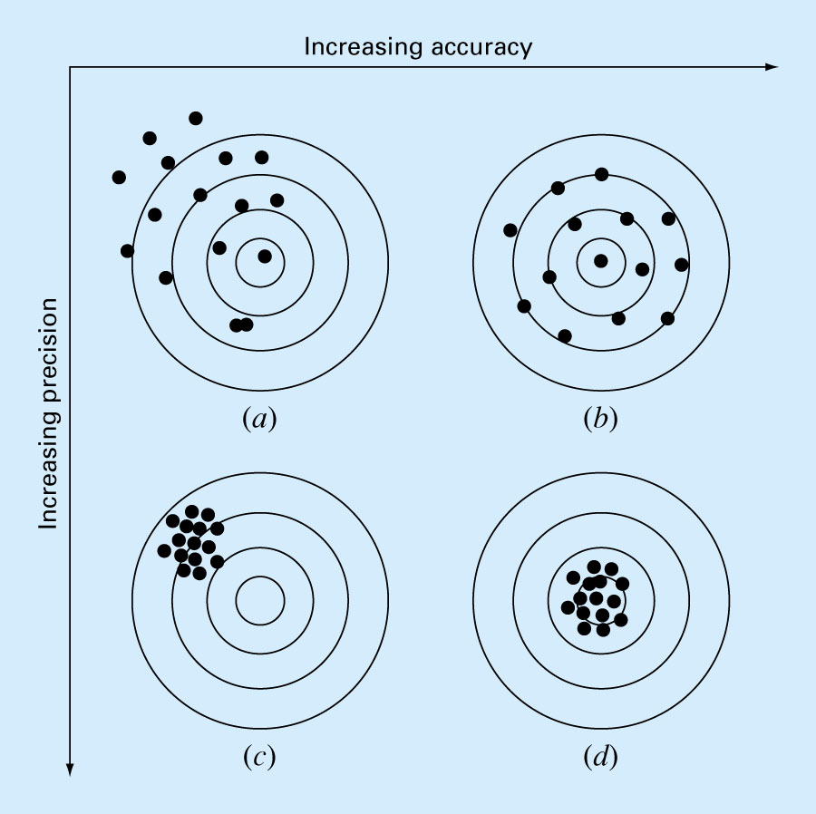
Fig. 3.2

Slide 5
Significant Figures
Number of significant figures indicates precision. Significant digits of a number are those that can be used with confidence, e.g., the number of certain digits plus one estimated digit.
53,800 How many significant figures?
5.38 x 10⁴ 3
5.380 x 10⁴ 4
5.3800 x 10⁴ 5
Zeros are sometimes used to locate the decimal point not significant figures.
0.00001753 4
0.0001753 4
0.001753 4

Slide 6
Error Definitions
True Value = Approximation + Error
E_{t} = True value – Approximation (+/-)
True error

Slide 7
For numerical methods, the true value will be known only when we deal with functions that can be solved analytically (simple systems). In real world applications, we usually not know the answer a priori. Then
Iterative approach, example Newton’s method
(+ / -)

Slide 8
Use absolute value.
Computations are repeated until stopping criterion is satisfied.
If the following criterion is met
you can be sure that the result is correct to at least n significant figures.
Pre-specified % tolerance based on the knowledge of your solution

Slide 9
Example 3.2
In mathematics, function can often be represented by infinite series. For example, the exponential function can be computed using the Maclaurin series exapansion as:
Thus, as more terms are added in sequence, the approximation becomes a better and better estimate.
Starting with the simplest version, e^{x}=1, add terms one at a time to estimate e^{0.5}. After each new term is added, compute the true and approximate percent relative errors. Note that the true value of e^{0.5} = 1.648721. Add terms until the absolute value of the approximate error estimate ε_{a} falls below a pre-specified error criterion ε_{s} conforming to three significant digits.

Slide 10
Round-off Errors
Numbers such as π, e, or cannot be expressed by a fixed number of significant figures.
Computers use a base-2 representation, they cannot precisely represent certain exact base-10 numbers.
Fractional quantities are typically represented in computer using “floating point” form, e.g.,
Integer part
exponent
mantissa
Base of the number system used

Slide 11
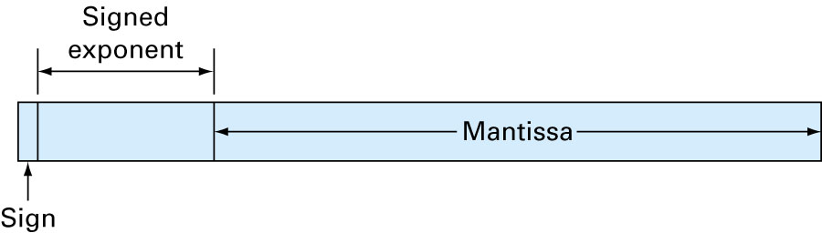
Integer part
exponent
mantissa
Base of the number system used

Slide 12
Suppose only 4 decimal places to be stored
Normalized to remove the leading zeroes. Multiply the mantissa by 10 and lower the exponent by 1
0.2941 x 10⁻¹
Additional significant figure is retained

Slide 13
Therefore
for a base-10 system 0.1 ≤m<1
for a base-2 system 0.5 ≤m<1
Floating point representation allows both fractions and very large numbers to be expressed on the computer. However,
Floating point numbers take up more room.
Take longer to process than integer numbers.
Round-off errors are introduced because mantissa holds only a finite number of significant figures.

Slide 14
Chopping
Example:
π=3.14159265358 to be stored on a base-10 system carrying 7 significant digits.
π=3.141592 chopping error ε_{t}=0.00000065
If rounded
π=3.141593 ε_{t}=0.00000035
Some machines use chopping, because rounding adds to the computational overhead. Since number of significant figures is large enough, resulting chopping error is negligible.

